Slide 1
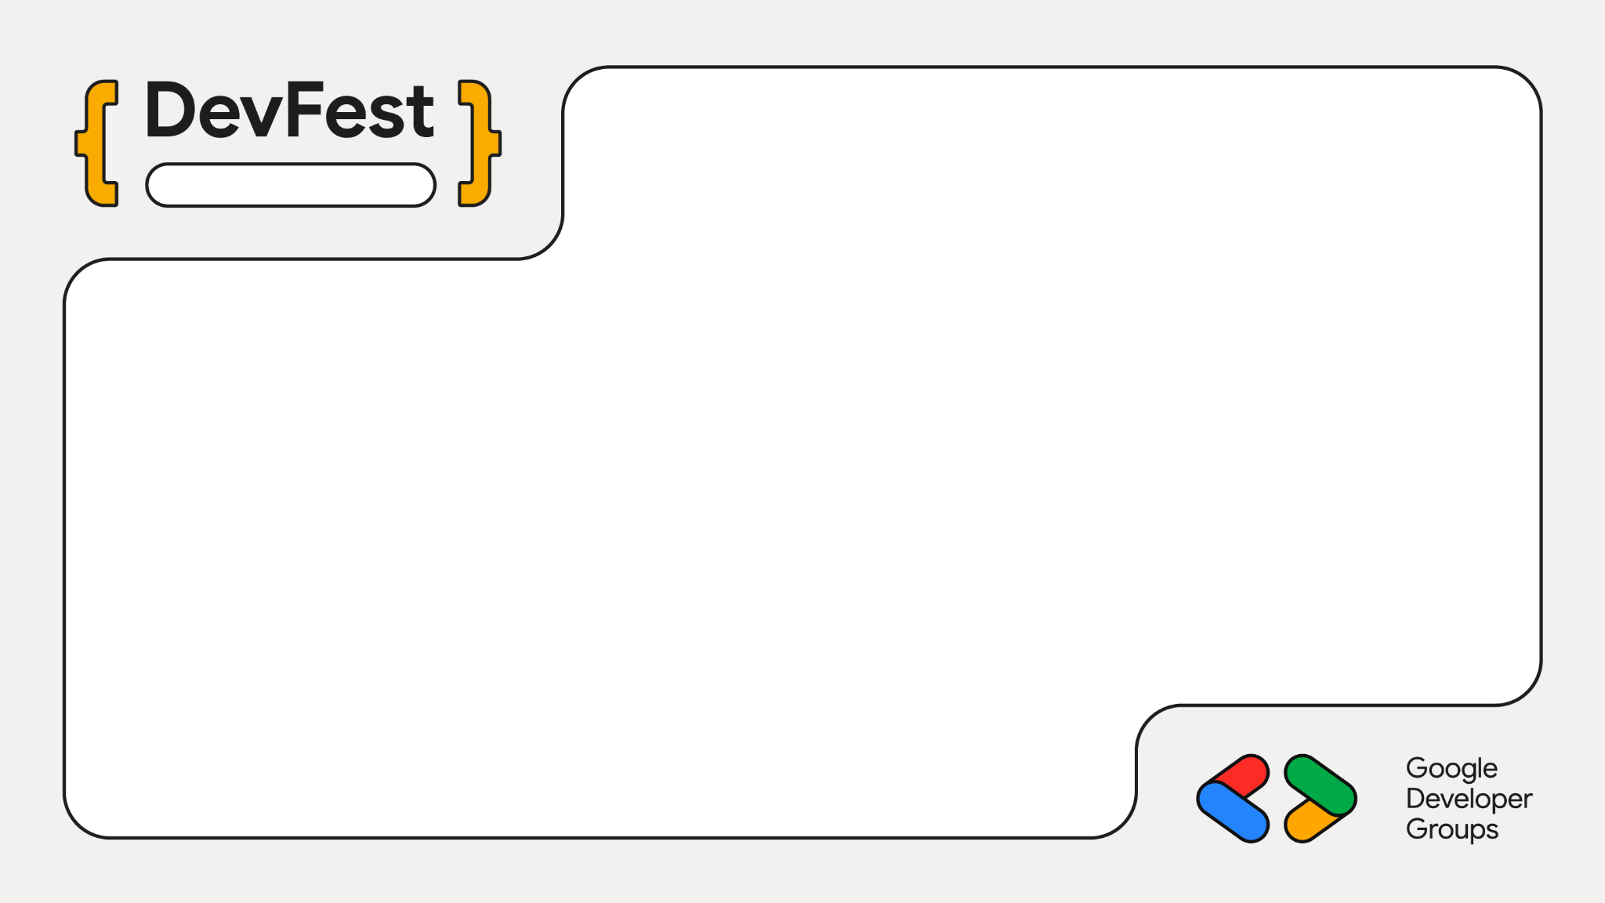
Modena
The digital assembly line: The Designing AI Agents That Work Like Ford's Factory
ZELDA AILINE LUCONI
Senior Cloud Architect, Datwave

Slide 2
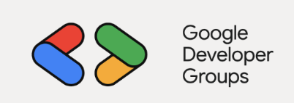



DevFest - Modena 2026
What LLM, Agents and Agentic AI bring to the table?
More creativity.
More impact.
More possibilities.

Slide 3

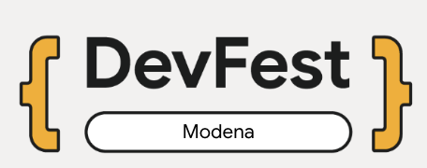
DevFest - Modena 2026
Before starting a little warning…
AI project graveyard
“The fate of many ambitious AI initiatives that begin with excitement but ultimately fail to deliver real business value, typically getting abandoned or stuck in the pilot phase”
How to avoid it?
Start from the business problem, not the technology: Define the specific challenge you aim to solve and use AI ONLY, if it is necessary.
Build for production from day one: Design the product from the very beginning while following policies and best practices.

Slide 4
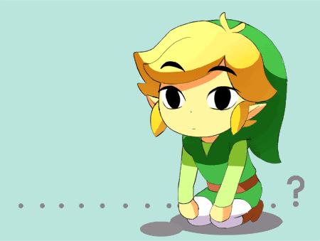
DevFest - Modena 2026
Who Am I
Zelda Ailine Luconi
I am not Zelda….
Over 8 years of experience in Cloud, Data, and AI.
started as a researcher at the University of Florence.
worked for 3 years as an AI Engineer at Samsung.
then in consulting at xTech BIP as a Data & Cloud Engineer.
collaborated with CNR (National Research Council).
currently working as a Senior AI & Cloud Architect at Datwave (Google Partner).
I love eating, traveling, and learning new languages — not only natural ones, but also programming languages.

Slide 5
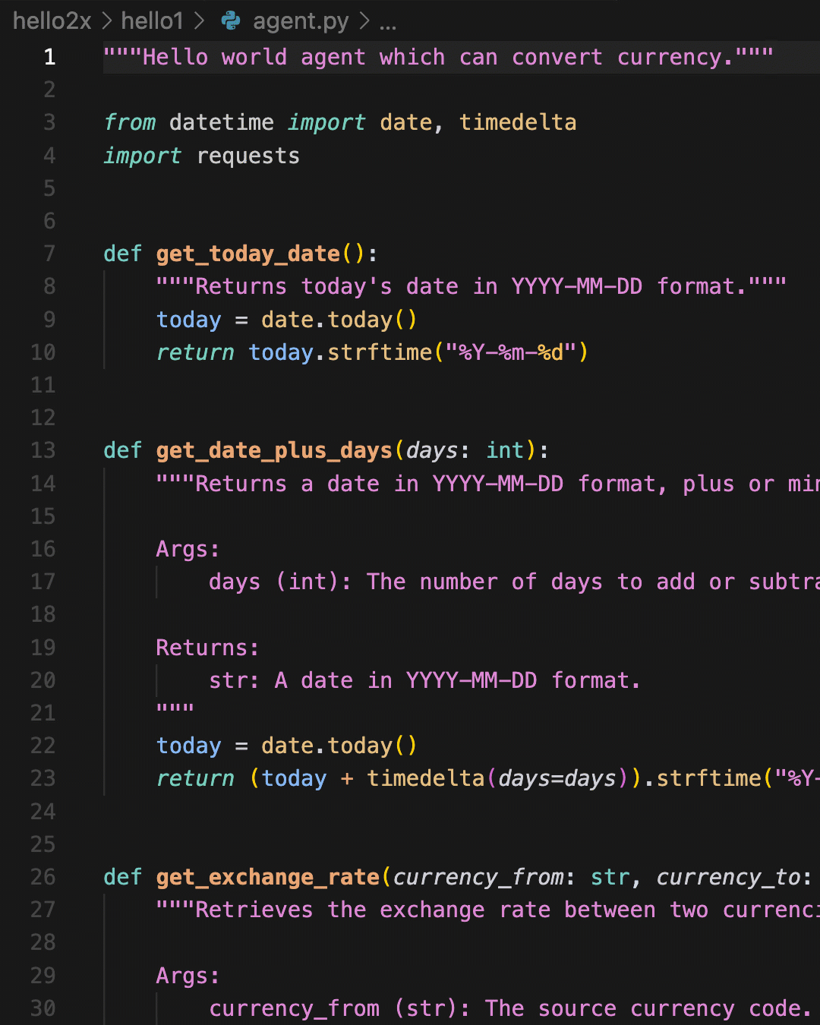
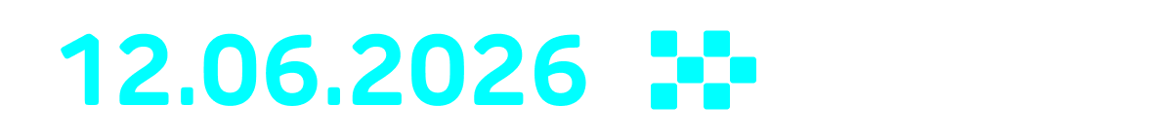

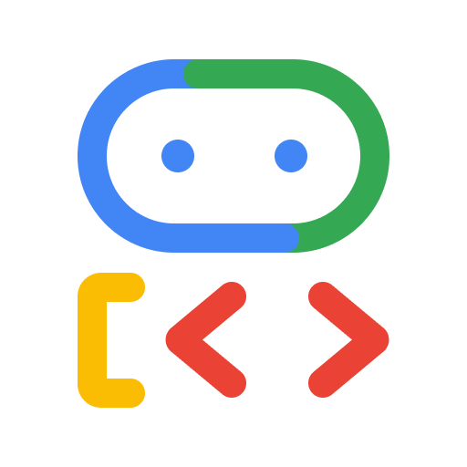

Let's Take an Example:
DevFest - Modena 2026
DevFest - Modena 2026
_AI EDITION
“Find the best stops based on the user's food preferences, their location, and the type of car (electric, LPG, etc.)”
An open-source framework (Apache 2.0) for building AI agents that supports Python (which we'll use), Go, and Java.
LET’S
TALK
CODE

Slide 6
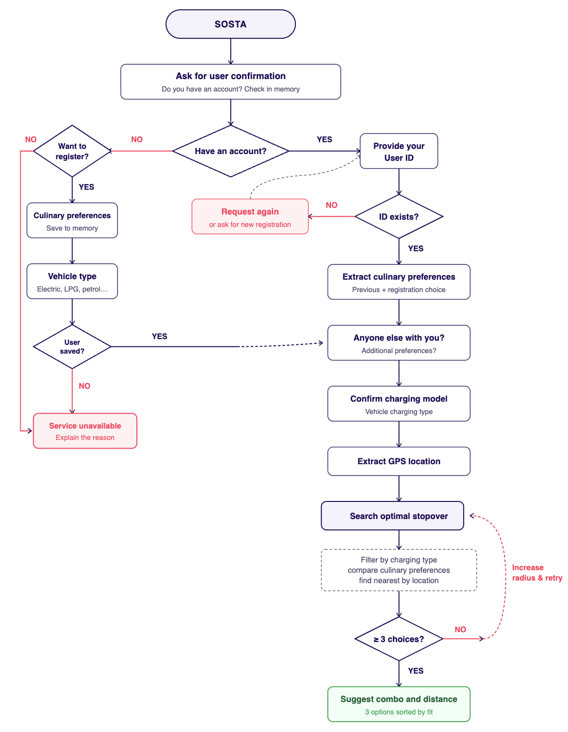
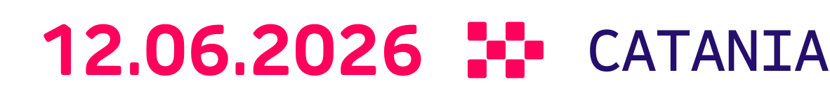

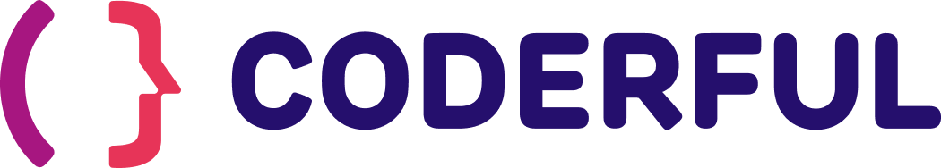
DevFest - Modena 2026
_AI EDITION
Start with the business problem
Requirements, Data & UX
Requirements:
best stop: closest one that satisfies customer's culinary preferences and refueling needs
create a memory: user's food preferences (requires registration/user ID).
conversational: possibility of verbal interaction
Data Sources:
db-stops: all available dining options with coordinates and refueling types.
food-kb: list of products and reviews for each dining option.
LET’S
TALK
CODE

Slide 7

DevFest - Modena 2026
_AI EDITION
Start with the business problem
Agent or Non-Agent, that is the question
Unstructured Data Management: The Database consists of raw menus, text, and user reviews; therefore, semantic matching and sentiment analysis are required.
Hyper-Personalization and Context: It is necessary to map the preferences of the individual user, collected in the past and in the present session, to have a personalized product.
Conversational UX: While driving, the user cannot fill out a dropdown menu, making a purely verbal interaction necessary.
LET’S
TALK
CODE

Slide 8

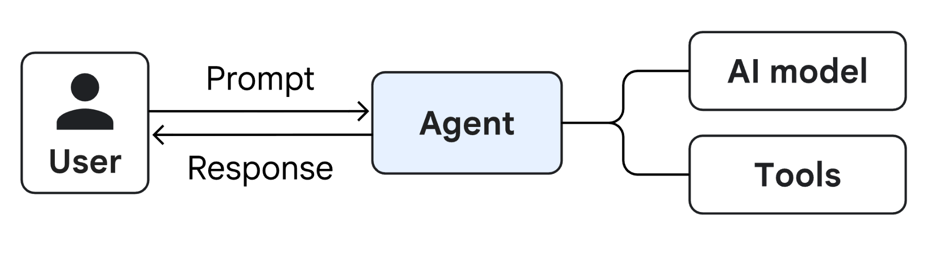
DevFest - Modena 2026
What is the most common, and often worst scenario
Hellish Single Agent Pattern
Context Dilution
The longer and more varied the prompt, the higher the risk that the AI suffers from context dilution, forgetting instructions or hallucinating.
Confirmation Bias
A single agent tends to confirm its own errors. If it makes a mistake at the beginning of its reasoning, it will struggle to correct itself on its own.
Rot Context
As token count grows, earlier instructions and facts lose priority, leading to hallucinations, topic drift, logic errors, and reduced accuracy in complex or multi-turn prompts.
Lack of Parallelization
You cannot run tasks in parallel if a single brain has to supervise every micro-step in sequence.
Lack of Specialization
A single agent will struggle to excel simultaneously in creative tasks, rigorous logical analysis, and mathematical calculations.

Slide 9
How to avoid all of this?
DevFest - Modena 2026
from Ford to today... with the digital assembly line

Slide 10
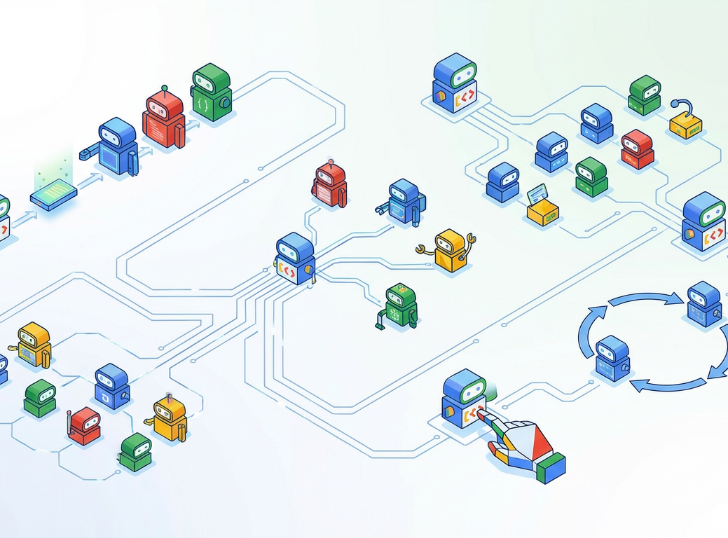
DevFest - Modena 2026
Let’s discuss about 3 main points of
The Assembly Line
How a 120-year-old manufacturing idea is quietly becoming the dominant paradigm for building AI systems at scale.
Structured workflow: Each station receives the output of its predecessor(s), applies its specific function, and passes the transformed artifact to the next station(s).
Technological heterogeneity: Each station can use a different language model, dedicated prompts, or specific tools (e.g., an expensive model for reasoning and a fast one for quality control).
Structured handoffs: The transfer of information between agents occurs via typed and clean data (e.g., JSON), reducing background noise and optimizing the context window.

Slide 11
Structured workflow
DevFest - Modena 2026
Each station receives the output of its predecessor(s), applies its specific function, and passes the transformed artifact to the next station(s).

Slide 12
Gatekeeper
DevFest - Modena 2026
_AI EDITION
First assembly line point
Structured workflow
Cameriere
🛠️🤖
Divide the Experience:
one task, one agent.
It is the microservices paradigm applied to AI: small, autonomous, and hyper-specialized modules collaborating to solve a complex problem.
Registratore
LET’S
TALK
CODE
Suggeritore

Slide 13
DevFest - Modena 2026
_AI EDITION
First assembly line point
Structured workflow
🛠️🤖
🛠️🤖
Non-Deterministic
Multi-Agents Workflows
Deterministic
Graph Workflows
Names vary based on frameworks, but as mentioned, we will focus on ADK.
LET’S
TALK
CODE

Slide 14
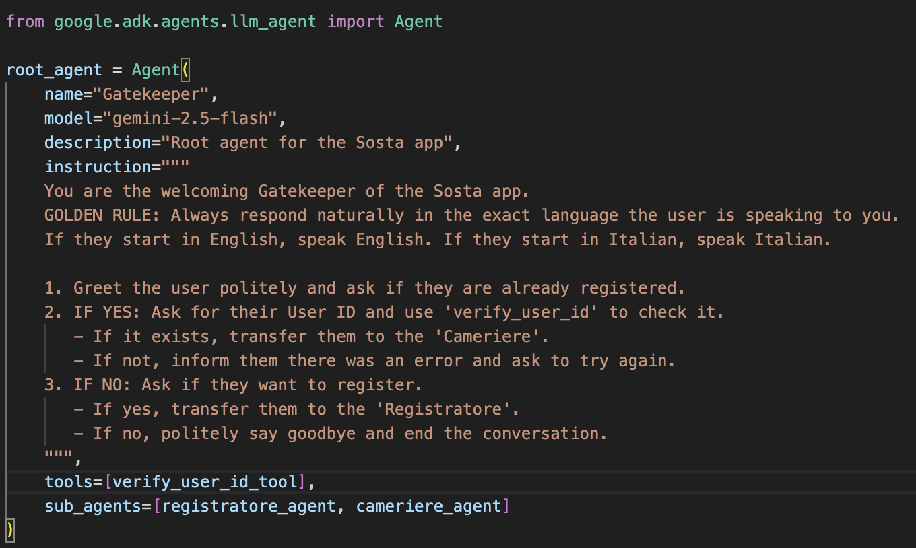
DevFest - Modena 2026
First assembly line point
Multi-system Agent
Coordinator Agent
Delegation of tasks
Subagents & Tools

Slide 15
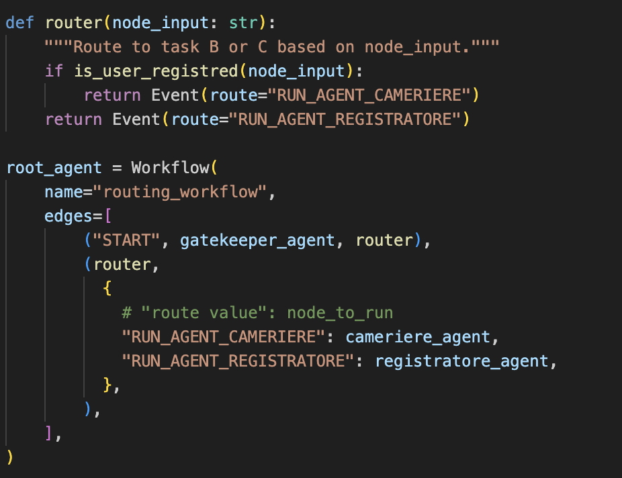
DevFest - Modena 2026
_AI EDITION
First assembly line point - Structured workflow
Graph Workflows
Routing and conditional branching
In a graph workflow in ADK, an orchestrator node handles the routing and conditional branching of tasks to 1 or more nodes.
Through the ADK's Workflow class, AI is used within nodes to process information, but the order of steps (the pipeline) is rigid and predictable.
Orchestrator Node
Coordinator Agent → Orchestrator Node
Delegation of tasks → Routing and conditional branching
Subagents and Tools → Execution Nodes
Execution Nodes
LET’S
TALK
CODE

Slide 16
Technological Heterogeneity
DevFest - Modena 2026
Each station can use a different language model, dedicated prompts, or specific tools.

Slide 17
DevFest - Modena 2026
_AI EDITION
Second assembly line point - Technological Heterogeneity
Sub-Agents vs. Tools
rigid functions written in pure code (e.g., GPS calculation or saving a user to a database).
🛠️
Tools
🤖
Sub
agents
secondary AI agents managed by a primary agent to execute specific tasks.
LET’S
TALK
CODE

Slide 18
DevFest - Modena 2026
_AI EDITION
Second assembly line point - Technological Heterogeneity
Expanding to ….
🔌
Model Context Protocol (MCP)
Agent → Data
Through MCP, the agent semantically queries external and unstructured knowledge bases (e.g., reviews) through JSON-RPC
Key Role: Standardizes how tools declare their capabilities and schemas to the LLM.
🌐
The A2A (Agent-to-Agent) Protocol
Agent→ Agent
Allows tasks to be decoupled and establishes communication between agents that are not within the same system.
Key Role: Uses dynamic discovery (via HTTP / REST with Agent Cards .well-known/agent.json).
LET’S
TALK
CODE

Slide 19
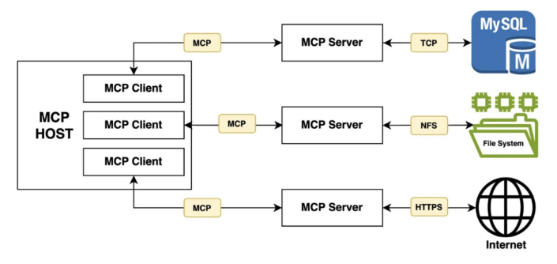
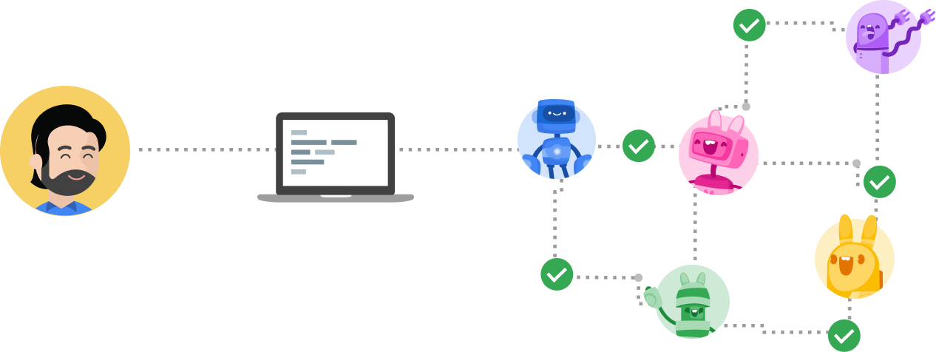
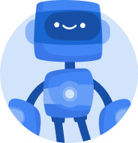
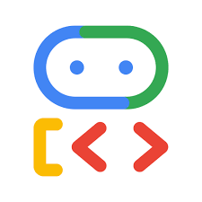
DevFest - Modena 2026
_AI EDITION
Second assembly line point - Technological Heterogeneity
Model Context Protocol
The Model Context Protocol (MCP) is an open standard to standardize the way artificial intelligence (AI) systems integrate and share data with external tools, systems, and data sources.
db-stops: all available dining options with coordinates and refueling types.
Agent
End-User
food-kb: list of products and reviews for each dining option.
Sosta App
LET’S
TALK
CODE

Slide 20
DevFest - Modena 2026
_AI EDITION
When to use
Direct Function Calling vs. MCP
1. Technological Freedom (The "Polyglot" Agent)
Direct Function Calling: Tied to a specific AI library/framework language (e.g., Python wrappers).
MCP: Fully framework-agnostic. The tool uses the standard MCP protocol and works across any framework without code rewrites.
2. Independent Scalability and Resource Management
Direct Function Calling: Agent and tools share the same runtime/container, forcing monolithic scaling for heavy workloads.
MCP: Deploy tools as independent microservices (e.g., Cloud Run/K8s) that scale compute based on their specific workload.
3. Security & Sandboxing
Direct Function Calling: Shared execution environment where the agent holds full cloud/DB credentials, increasing risk during prompt injection.
MCP: Isolated sandboxed environment. The agent never touches underlying DB credentials and communicates via structured requests.
4. Enterprise Governance & Infrastructure Flexibility
Direct Function Calling: Decentralized logic requiring code updates, prompt re-testing, and redeployment when backend infrastructure or schemas change.
MCP: Centralized control for access, rate limits, and audit logs. Backend/DB updates happen strictly inside the MCP server without touching agent code.
LET’S
TALK
CODE

Slide 21





DevFest - Modena 2026
_AI EDITION
Second assembly line point - Technological Heterogeneity
Agent to Agent (A2A)
The A2A protocol allows different AI agents (e.g. from ADK, CrewAI, LangGraph) to "speak the same language" (a common protocol) and follow specific processes to complete tasks together.
Specialized Agent 1
(e.g. ADK)
Specialized Agent 1
(e.g. ADK)
Frontend & Host Agent
A2A Protocol
Specialized Agent 2
(e.g. LangGraph)
A2A Protocol
Specialized Agent 2
(e.g. LangGraph)
Client/Router
Agent
Client/Router
Agent
…
…
End-User
A2A Protocol
End-User
Specialized Agent N
(e.g. CrewAI)
Client
Specialized Agent N
(e.g. CrewAI)
A2A Client
(Cameriere Agent)
Servers
(Remote Agents)
A2A Servers
(Remote Suggeritore Agents)
LET’S
TALK
CODE

Slide 22
DevFest - Modena 2026
_AI EDITION
When to use
Sub-agents vs. A2A
1. Technological Freedom (The "Polyglot" Agent)
Sub-agents Everything must be executed in the same process and in the same language. If you want to use a specific Node.js library for a tool, you cannot do so if the rest is in Python.
A2A The Waiter agent can be written in Python, while the Recommender could be developed in Node.js, Go, or Java. Agents only care about the A2A JSON-RPC protocol.
2. Independent Scalability and Resource Management
Sub-agents If the Recommender runs heavy DB analysis consuming 4GB of RAM, the entire Agent will need at least that amount of RAM.
A2A You can host the Recommender on a high-memory machine and keep the Gatekeeper on a tiny, inexpensive instance. They scale independently based on their specific workload.
3. Security and Environment Isolation
Sub-agents Every agent shares the same environment variables and secrets. If one of them is compromised or misconfigured, they all are.
A2A This is a model where what each agent can "see" and "do" is strictly limited.
4. Team Collaboration (or Between Different Companies)
Sub-agents To add a sub-agent, its source code is required and must be "imported" into your project.
A2A All it takes is the URL and the agent-card.json file. One team can develop and manage the Waiter agent and another team the Recommender agent, communicating with a "handshake" directly over the network.
LET’S
TALK
CODE

Slide 23
Structured handoffs
DevFest - Modena 2026
Information transfer between agents occurs via typed and clean data (e.g. JSON), reducing background noise and optimizing the context window.

Slide 24
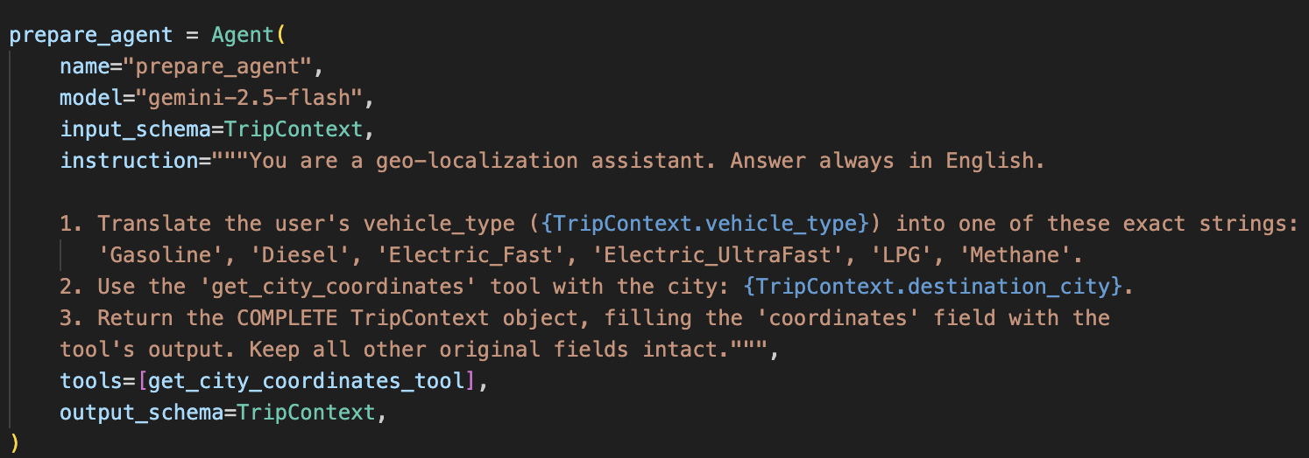
DevFest - Modena 2026
_AI EDITION
Third assembly line point - Structured handoffs
Input and output schemas
define exactly what data a software agent or an artificial intelligence model can receive as input and what it is required to return as output.
LET’S
TALK
CODE

Slide 25
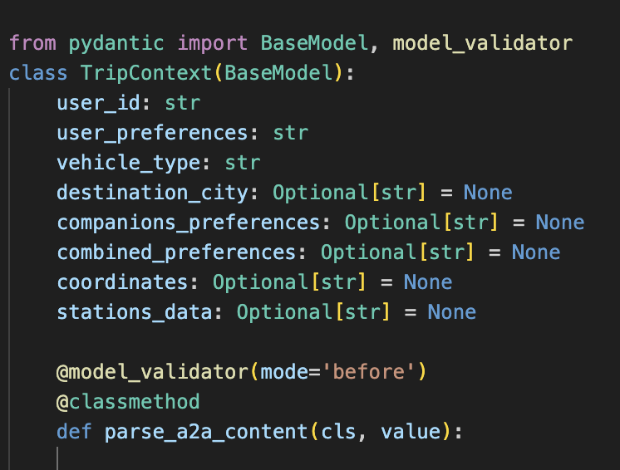
DevFest - Modena 2026
_AI EDITION
Third assembly line point - Structured handoffs
Input and output schemas
Information transfer between agents occurs via typed and clean data (e.g. JSON), reducing background noise and optimizing the context window.
Strict Type Enforcement: Pydantic doesn't just verify data types, but actively converts and cleans them. If an input arrives as a string "123" but the schema expects an integer (int), Pydantic automatically corrects it before it reaches the LLM.
Structural Hallucinations: Prevents the AI agent from inventing non-existent fields or returning partial/corrupted JSON. If the LLM's output does not 100% comply with the set schema, the framework intercepts the runtime error, forcing the model to self-correct before breaking the chain (Self-Correction).
LET’S
TALK
CODE

Slide 26
And in the end...
DevFest - Modena 2026
Let's put it all together

Slide 27
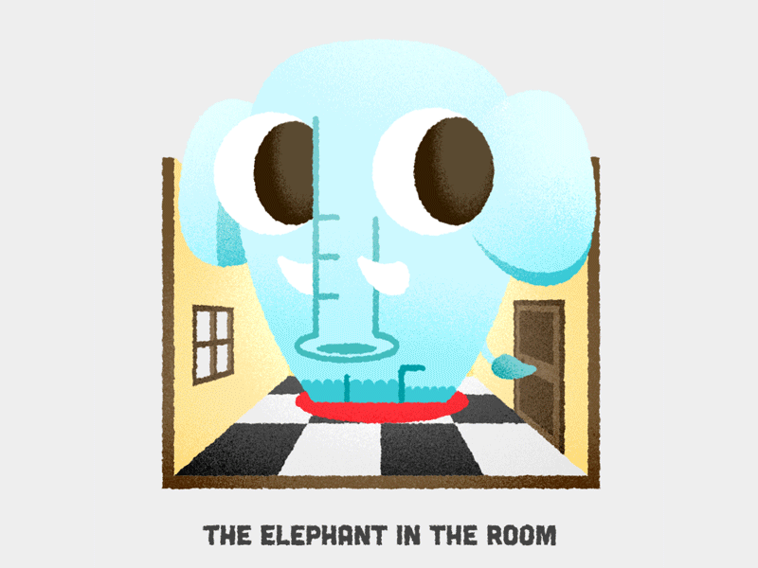
Gatekeeper
DevFest - Modena 2026
The final
Architecture
Coordinator
Cameriere
SubAgent
SubAgent
Registratore
Blackboard Pattern
Session, Context, and Memory
TripContext
A2A Protocol
Tool
LET’S
TALK
CODE
Suggeritore
MCP with
data sources

Slide 28
DevFest - Modena 2026
_AI EDITION
Final Thought
AI is not the answer to everything
💸
Explosive costs at scale
🌍
Hidden environmental costs
Multi-agent orchestration costs more than microservices and is even slower in some cases.
Each LLM inference consumes 10-100x more energy than a SQL query. Token = CO₂. The cost is not just monetary.
🔧
Maintenance complexity
🔍
Impossible debugging
multiple agents = multiple failure points, prompt drift, prompt versioning. The system degrades silently.
A SQL bug has a stack trace. A failing agent is a black box. You can't always understand why it said what it said.
LET’S
TALK
CODE

Slide 29
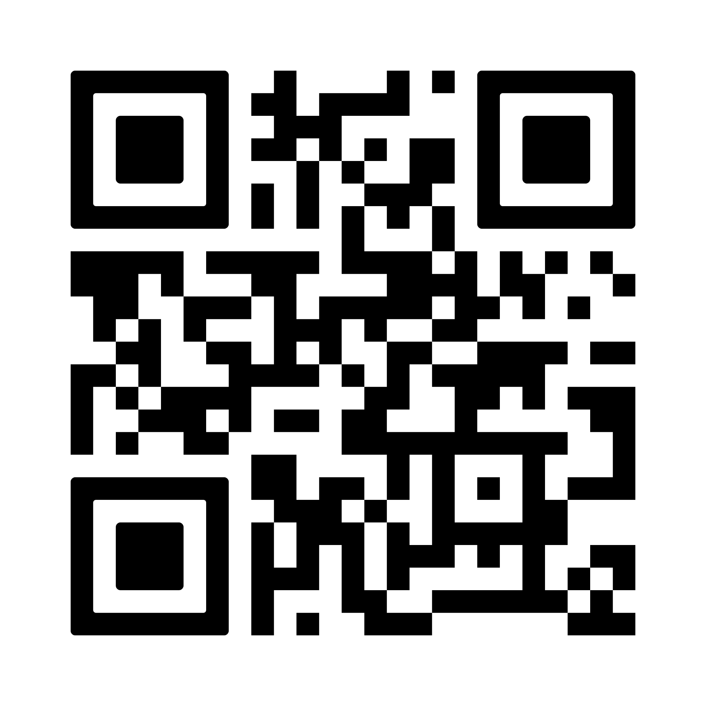

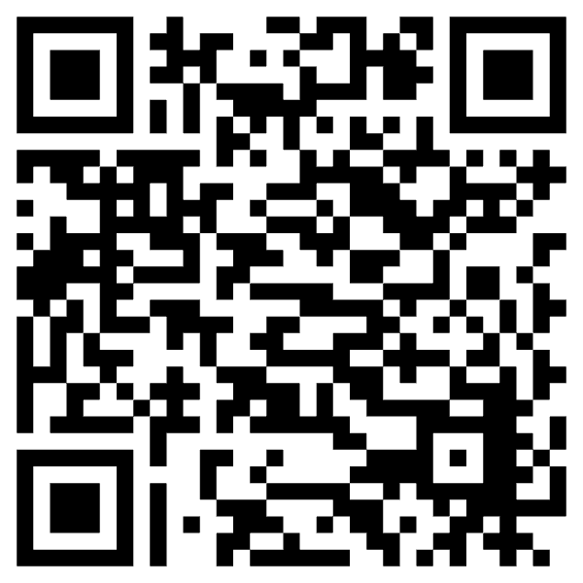
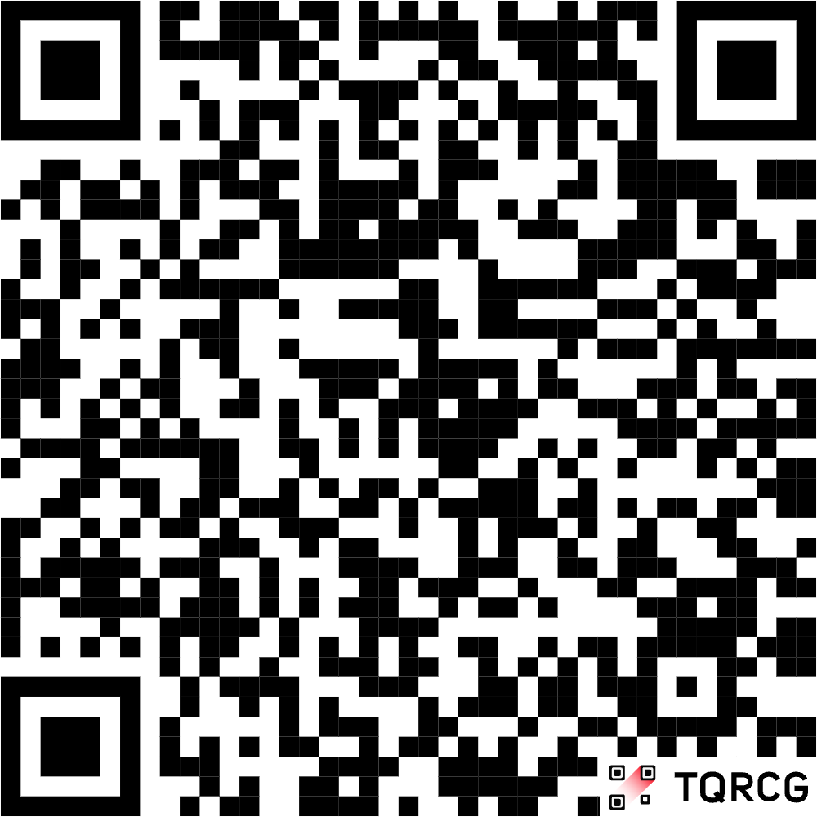
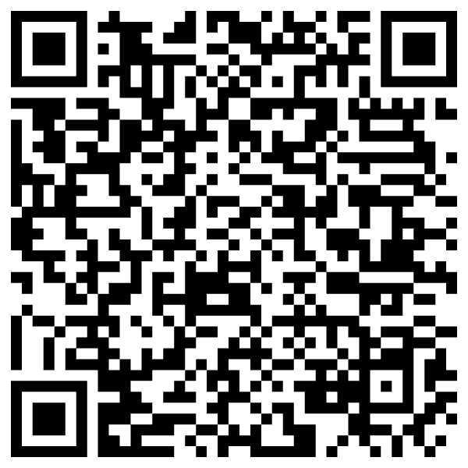
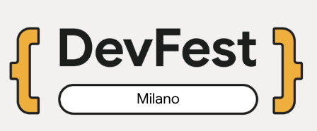
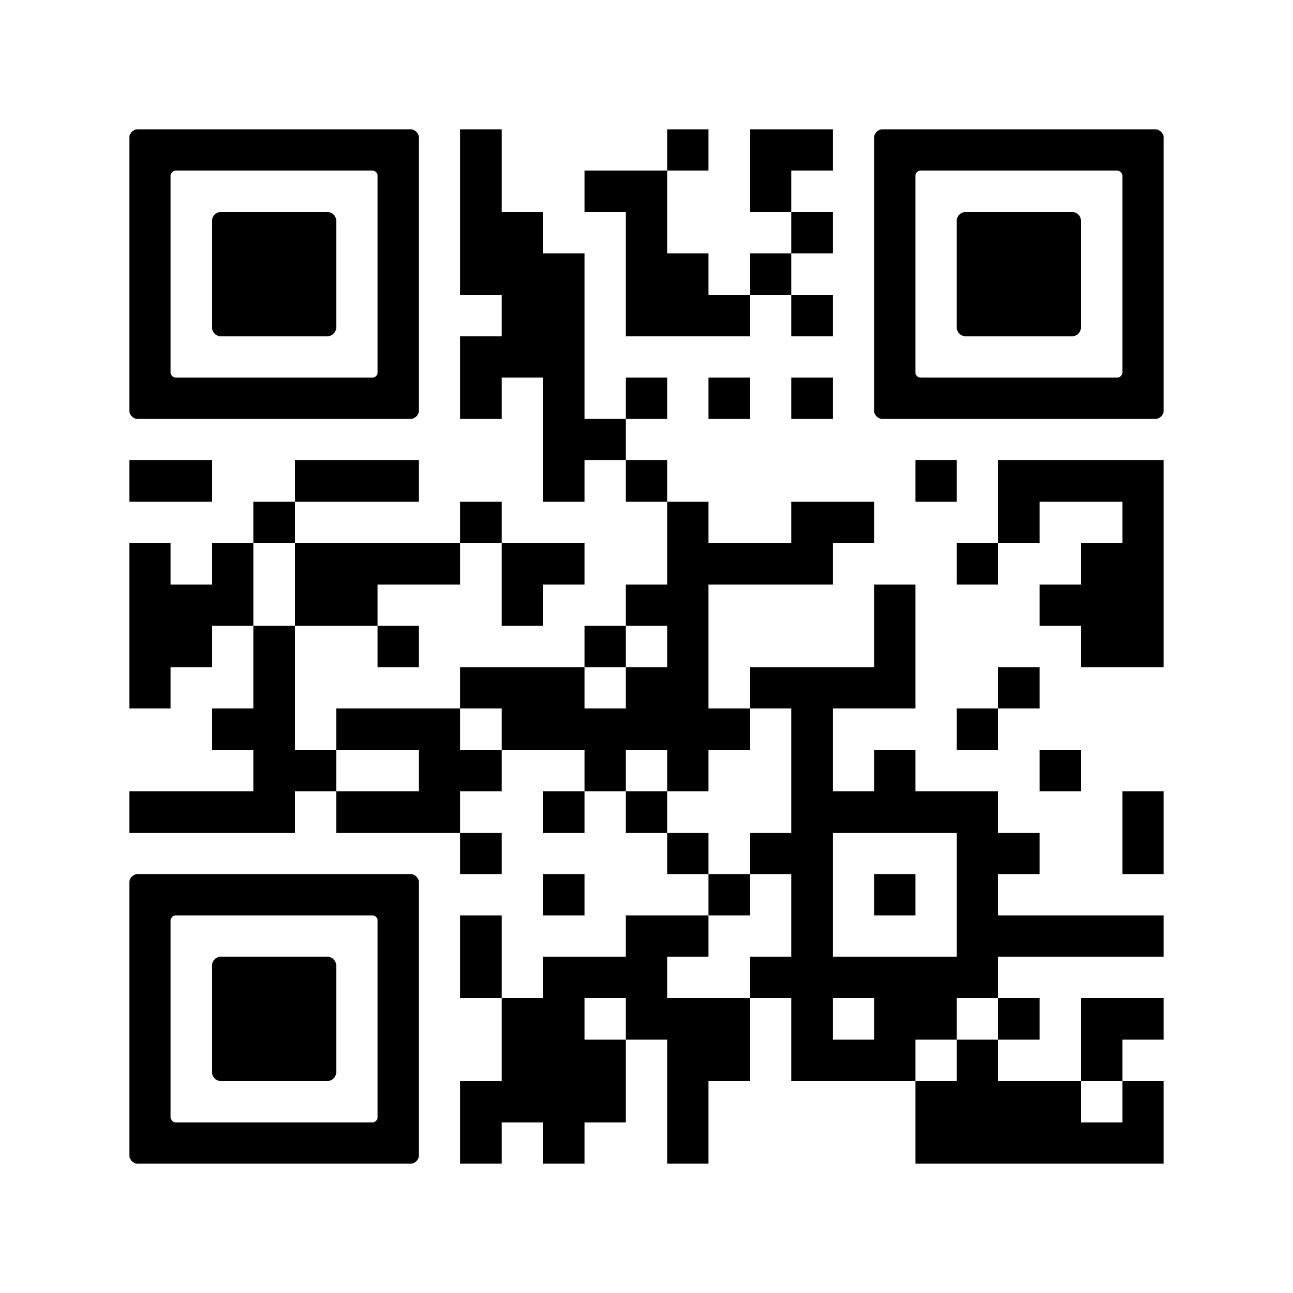

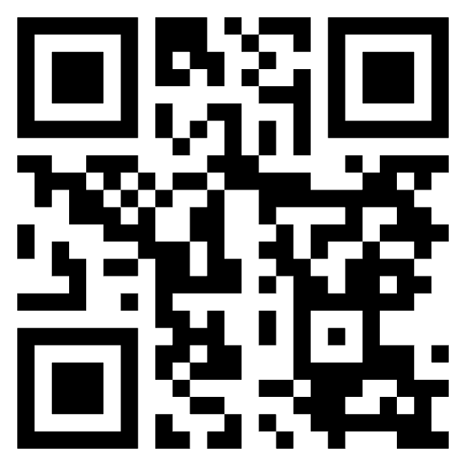
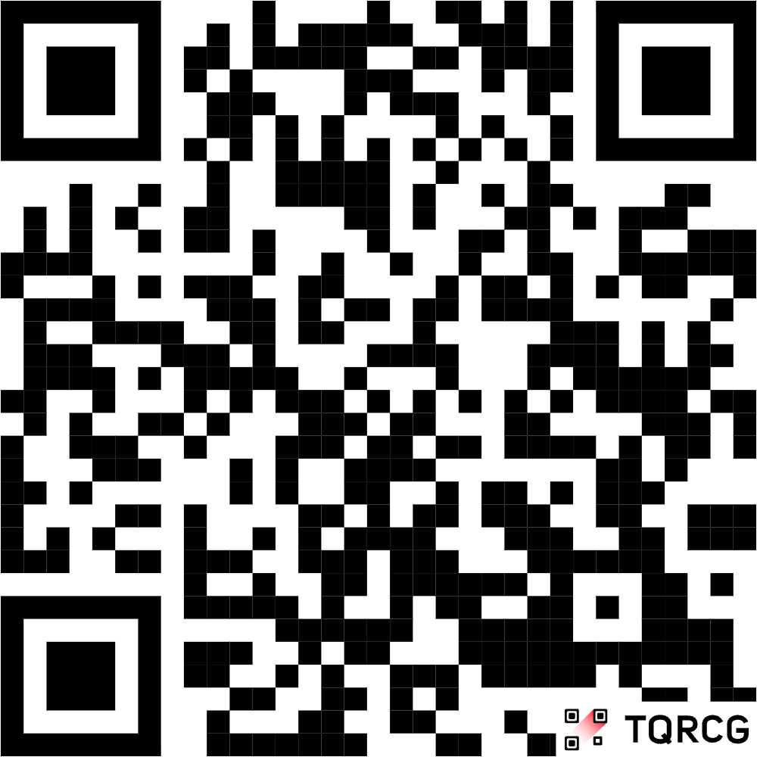
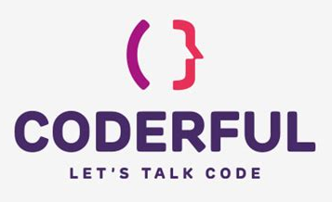
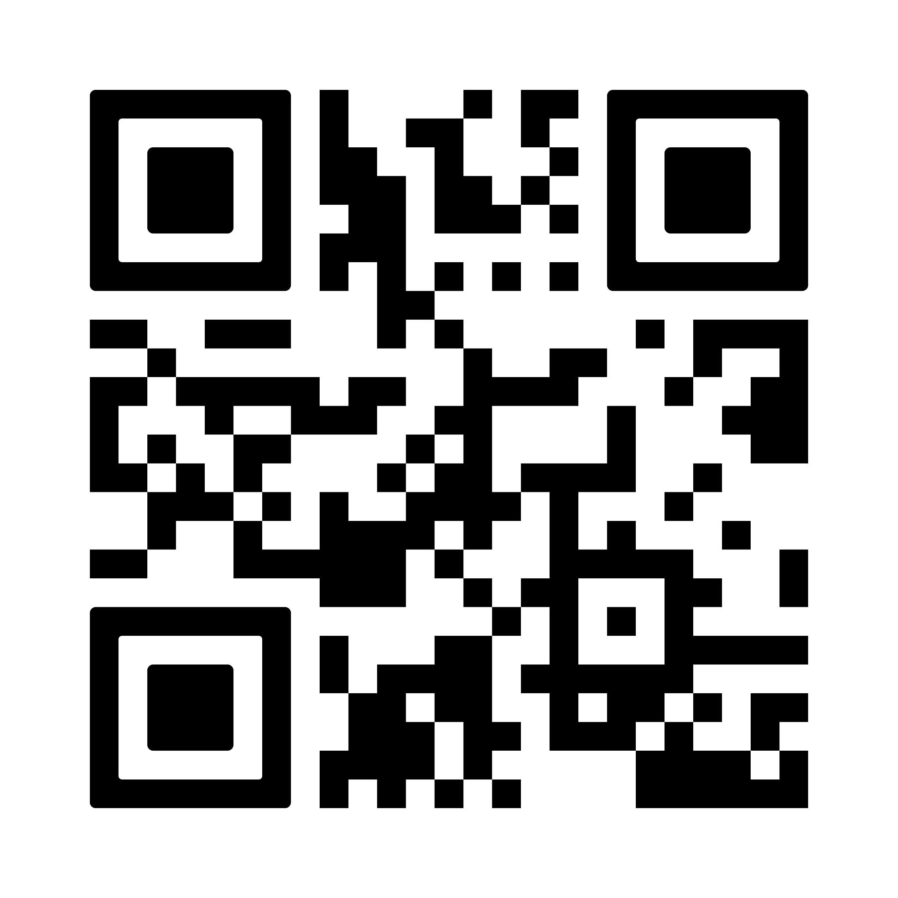

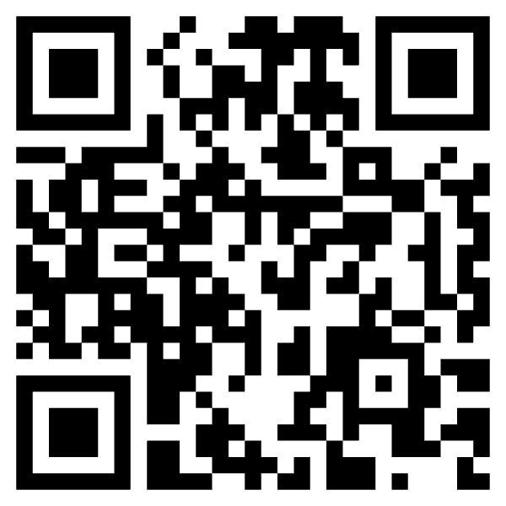
Q&A
DevFest - Modena 2026
What to stay in contact…

